Slide 1
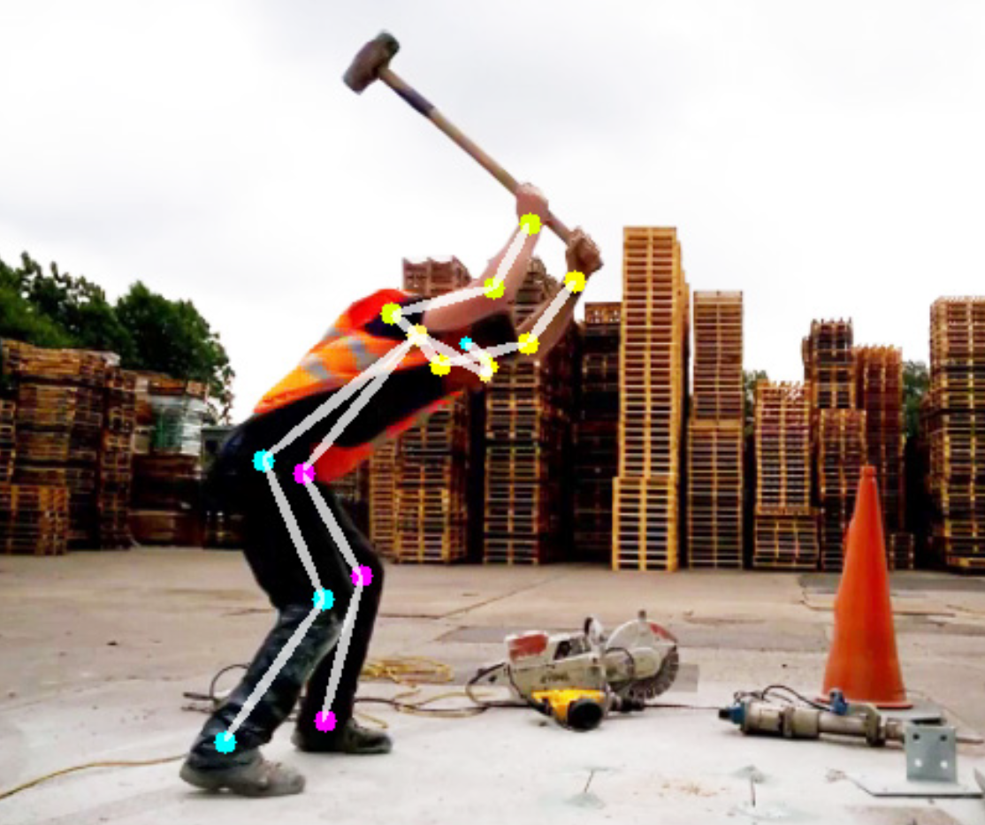
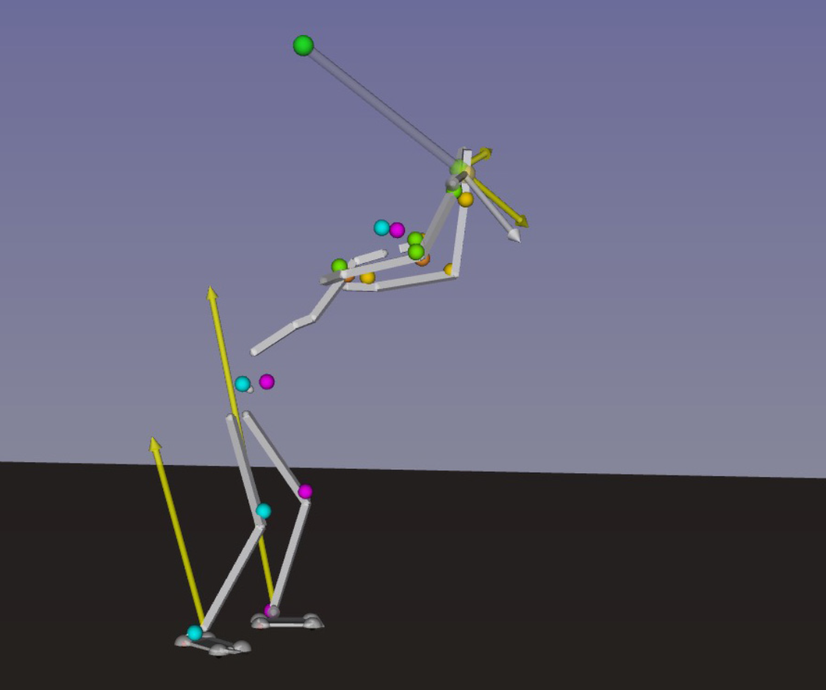




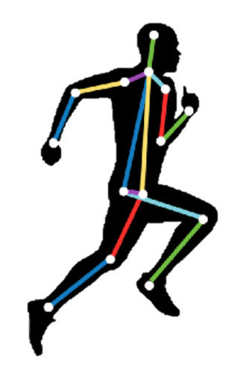


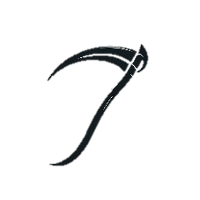
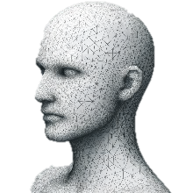



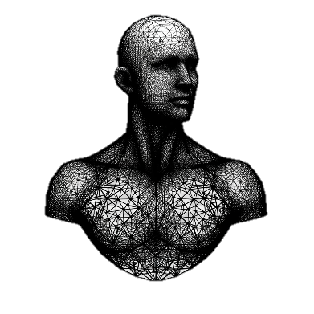
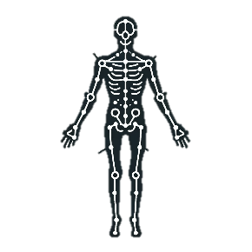
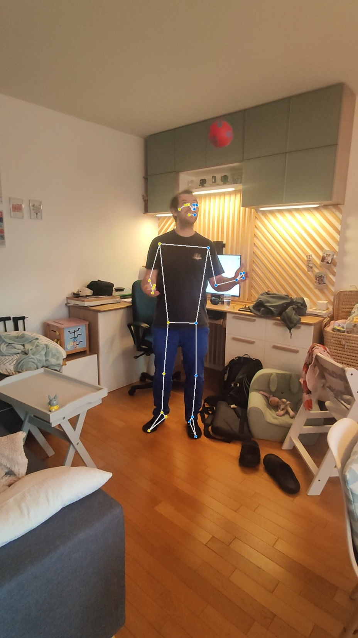
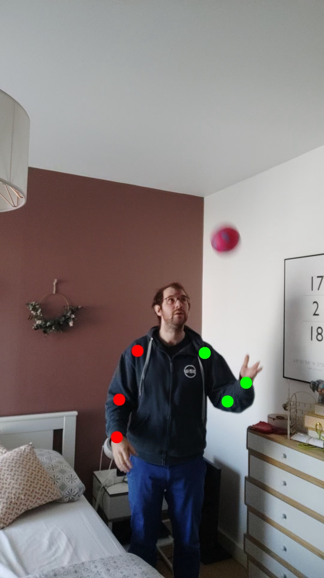
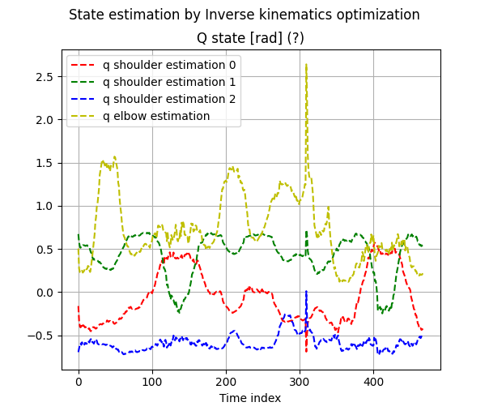
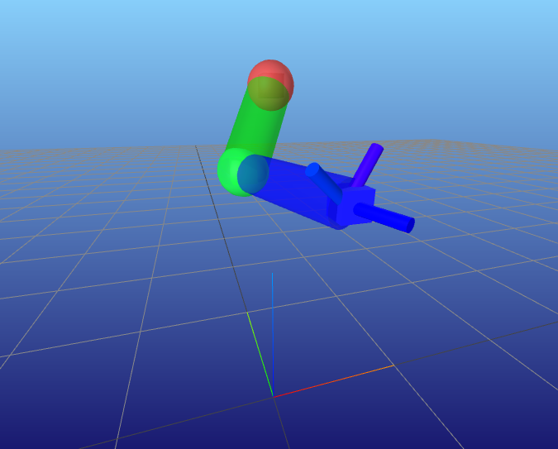





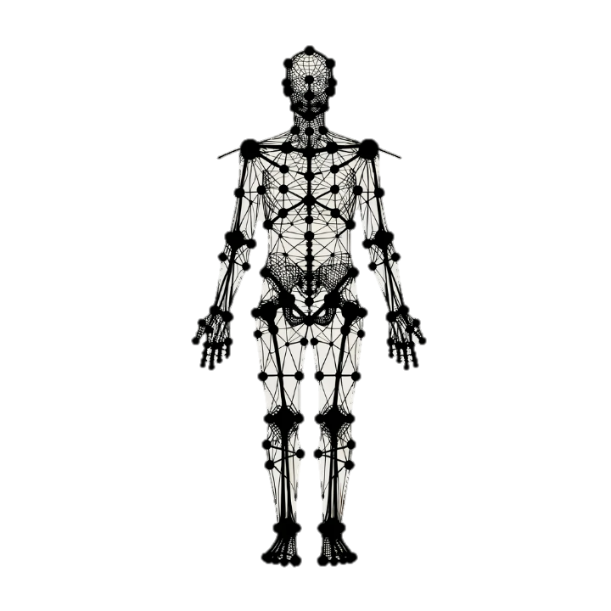
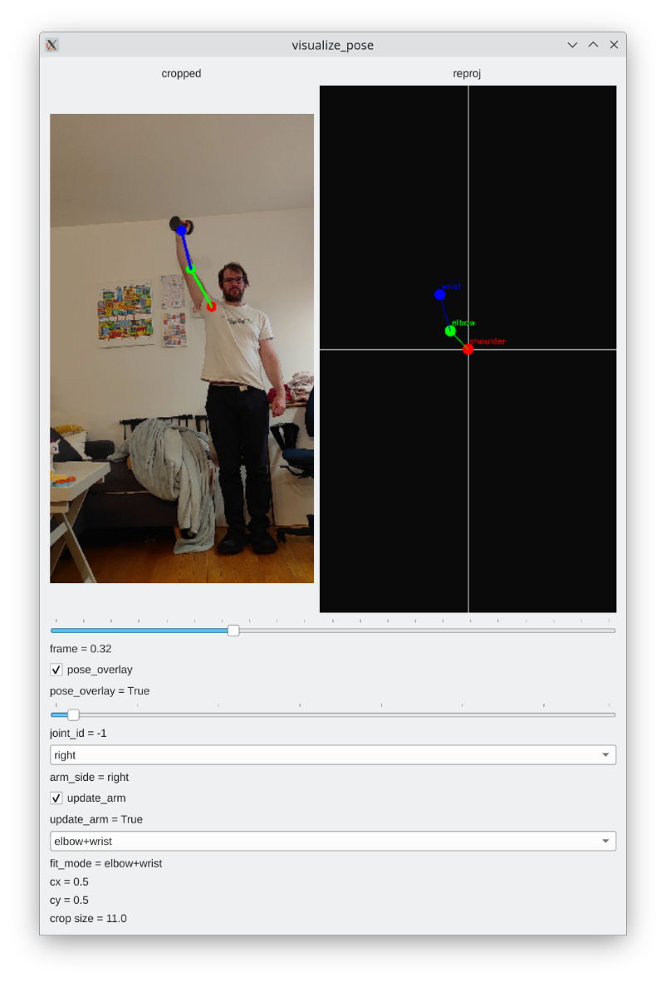
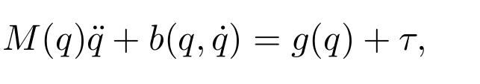
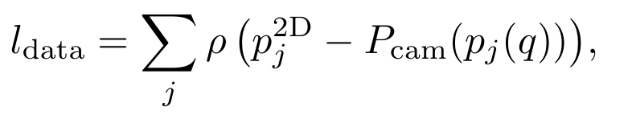
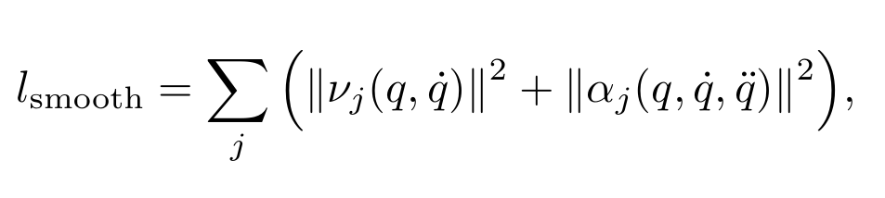
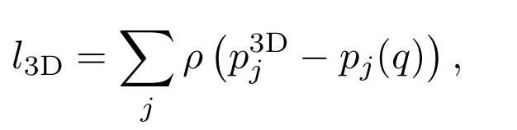
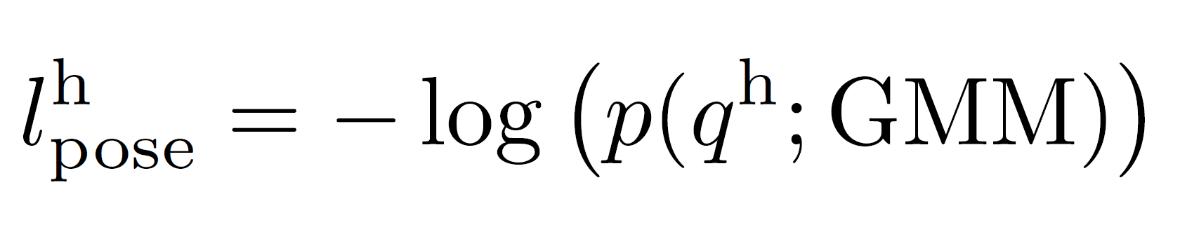
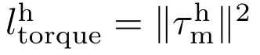




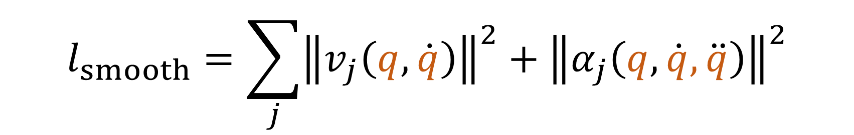
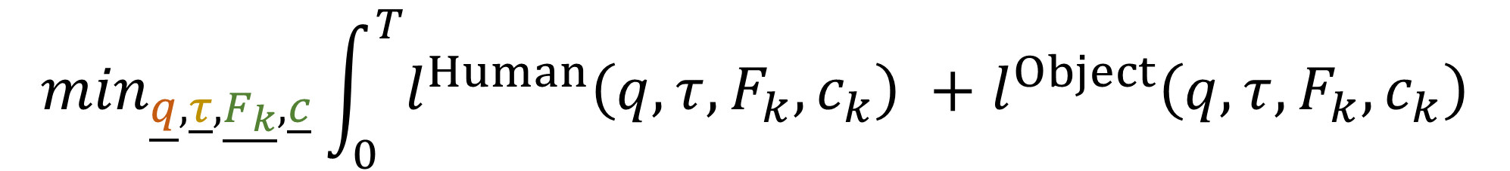
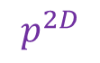
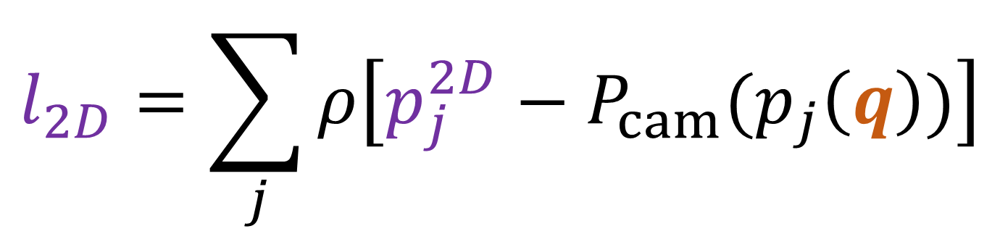


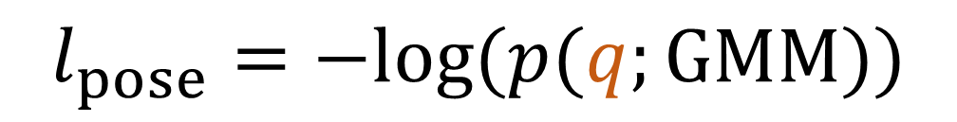
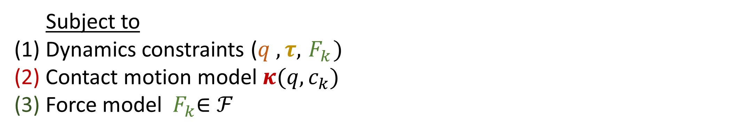
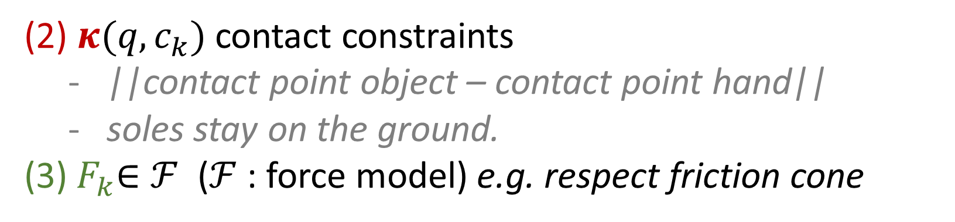
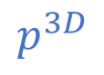
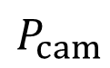
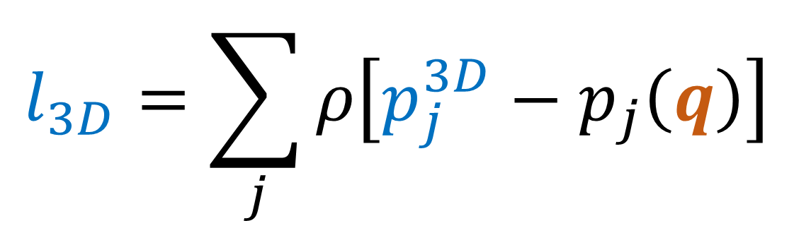
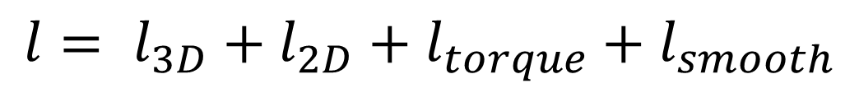

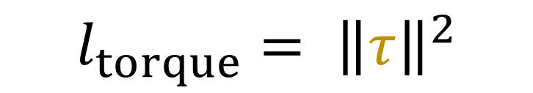
Estimating 3D Motion and Forces of Person-Object
Interactions from Monocular Video
Reviewed by Matthieu Dinot, Balthazar Neveu
Goal: without motion capture
from non-stereo videos in the wild
reconstruct a digital twin of a human
3D body motion
body torques
contact forces
→ in order to do behavior cloning on robots
$$p^{3D}$$
$$κ_{k}$$
$$p^{2D}$$
$$q$$
$$τ$$
$$F_{k}$$
POSE ESTIMATION
DIGITAL TWIN
$$P_{cam}$$
Vision
Optimizer
Inverse dynamics
Original paper’s approach
CONTACT
DETECTION
ResNet
2D POSE
ESTIMATION
OpenPose
RGB FRAMES
OBJECT DETECTION
Mask R-CNN
3D POSE ESTIMATION
HMR
$$\min_{\underline{q},\underline{τ},\underline{F_{k}}, \underline{c}}\int_{0}^{T}{l^{Human}\left(q,τ,F_{k},c_{k}\right) +l^{Object}\left(q,τ,F_{k},c_{k}\right)}$$
CONTACT POINTS
2D POSITIONS
MASKS - BOUNDING BOXES
3D POSITIONS
Minimize costs over
States, Torques , Forces,
Contacts , Camera pose
Subject to
(1) Dynamics constraints ($q , τ,{ F}_{k})$
(2) Contact motion model $κ(q,c_{k})$
(3) Force model ${ F}_{k}∈ℱ$
OPTIMIZER
Motion priors
Data fidelity
$$l_{smooth}=\sum_{j}{{\left\|v_{j}\left(q, \dot{q}\right)\right\|}^{2}+{\left\|α_{j}\left(q, \dot{q}, \ddot{q}\right)\right\|}^{2}}$$
(1) Lagrange dynamics constraints
Constraints
2D reprojection error
$$l_{2D}=\sum_{j}{ρ\left[p_{j}^{2D}−P_{cam}(p_{j}\left(q\right))\right]}$$
Linear velocity
Linear acceleration
$$M\left(q\right)\ddot{q}+b\left(q, \dot{q}\right)=g\left(q\right)+τ$$
$$l_{pose}=−log⁡(p(q;GMM))$$
(2) $κ(q,c_{k})$ contact constraints
||contact point object – contact point hand||
soles stay on the ground.
(3)${ F}_{k}∈ℱ$ ($ℱ$: force model) e.g. respect friction cone
Vision
3D forward kinematics error
Initialization
$$l_{3D}=\sum_{j}{ρ\left[p_{j}^{3D}−p_{j}\left(q\right)\right]}$$
Negative log likelihood of the pose
RGB FRAMES
Use inverse kinematics on the Mediapipe 3D arm positions
$$l_{torque}= {\left\|τ\right\|}^{2}$$
2D & 3D POSE
ESTIMATION
MediaPipe
(+ normalized arm lengths)
Evaluation
Torque norm
Limitations, questions and difficulties
PROTOTYPE
Parkour dataset
- How accurate are the estimated torques?
- Difficulty for the benchmark
- Multiple staged pipeline with inter-dependancies.
Off the shelf
Vicon / Force sensors
2D POSITIONS
3D POSITIONS
(**) 4 github projects
Optimizer
(*)Why not re-injecting the estimated poses and torques into a simulator?
$${l= l}_{3D}+l_{2D}+l_{torque}+l_{smooth}$$
Detector performances
Physics plausability
Relaxed dynamics constraints
Motion priors
Data fidelity terms
Camera intrinsics and extrinsics
Computed with finite differences
2D reprojection error
Linear velocities
Linear accelerations
Error on 3D points
negative log likelihood of the pose
Torque norm
1 ResNet per
Our work
Simplifications: Arm model, No objects, Static calibrated camera

Slide 4
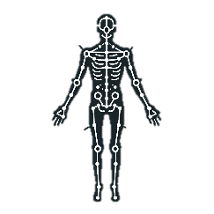


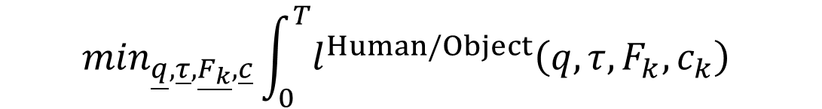
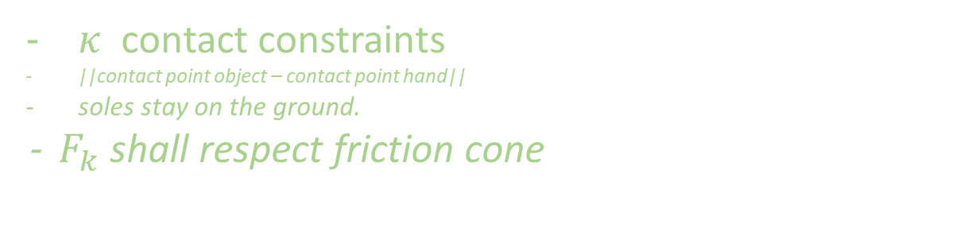
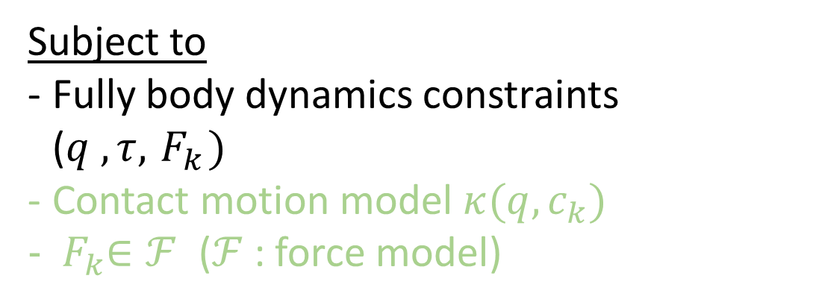
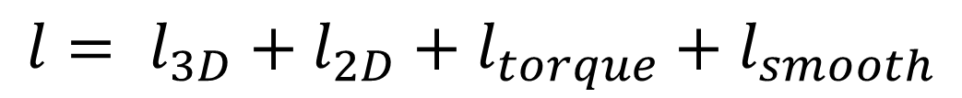
Estimating 3D Motion and Forces of Person-Object Interactions from Monocular Video
Reviewed by Matthieu Dinot, Balthazar Neveu
Original paper’s approach
Our work
Goal: reconstruct 3D motion, body torques and contact forces
from non-stereo videos in the wild without motion capture
→ in order to do behavior cloning on robots
Simplifications: Arm model, No objets, Static calibrated camera
Vision
Vision
CONTACT
DETECTION
ResNet
2D POSE
ESTIMATION
OpenPose
RGB FRAMES
OBJECT DETECTION
Mask R-CNN
3D POSE ESTIMATION
HMR
RGB FRAMES
2D & 3D POSE
ESTIMATION
MediaPipe
Fine-tuned
Off the shelf
Fine-tuned
Off the shelf
Off the shelf
CONTACT POINTS
2D POSITIONS
OPTIMIZER
MASKS - BOUNDING BOXES
3D JOINTS POSITIONS
3D POSITIONS
Optimizer
Initialization
2D POSITIONS
$$\min_{\underline{q},\underline{τ},\underline{F_{k}}, \underline{c}}\int_{0}^{T}{l^{Human/Object}\left(q,τ,F_{k},c_{k}\right) }$$
Subject to
Fully body dynamics constraints ($q , τ,{ F}_{k})$
Contact motion model $κ(q,c_{k})$
${ F}_{k}∈ℱ$ ($ℱ$: force model)
PROTOTYPE
Use inverse kinematics on the Mediapipe 3D arm positions (normalized arm lengths)
Optimize over States, Torques , Forces, Contacts
$κ$ contact constraints
||contact point object – contact point hand||
soles stay on the ground.
- ${ F}_{k}$ shall respect friction cone
Physics plausability
Relaxed dynamics constraints
Motion priors
Data fidelity terms
Camera intrinsics and extrinsics
Computed with finite differences
Optimizer
2D reprojection error
Linear velocities
Linear accelerations
$${l= l}_{3D}+l_{2D}+l_{torque}+l_{smooth}$$
Error on 3D points
negative log likelihood of the pose
Torque norm
Evaluation
Limitations, questions and difficulties
Vicon?
+ Pressure sensor
Parkour dataset
- How accurate are the estimated torques?
- Difficulty for the benchmark
- Multiple staged pipeline with inter-dependancies.
Why not re-injecting the estimated
poses and torques into a simulator?
1 ResNet per
4 github projects
Detector performances

